Slide 1
The golden Ring of Russia
authors: Saprykina L.W Khomiakova M.N

Slide 2
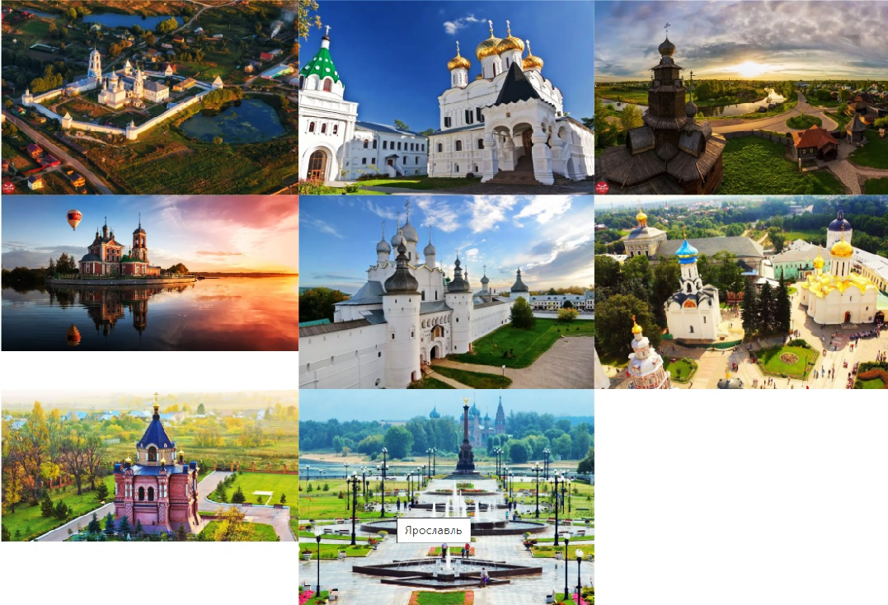
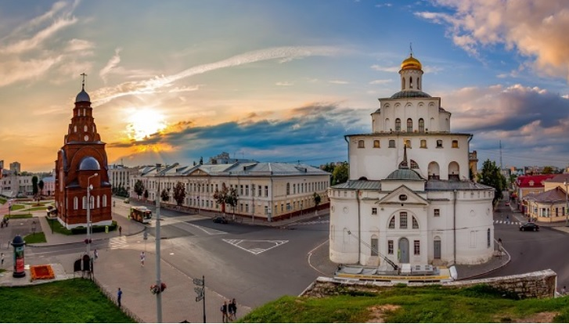
The Golden Ring is one of Russia’s most famous tourist routes. It includes some very special towns that lie to the northeast of Moscow. Each town has its own special charm and history.

Slide 3
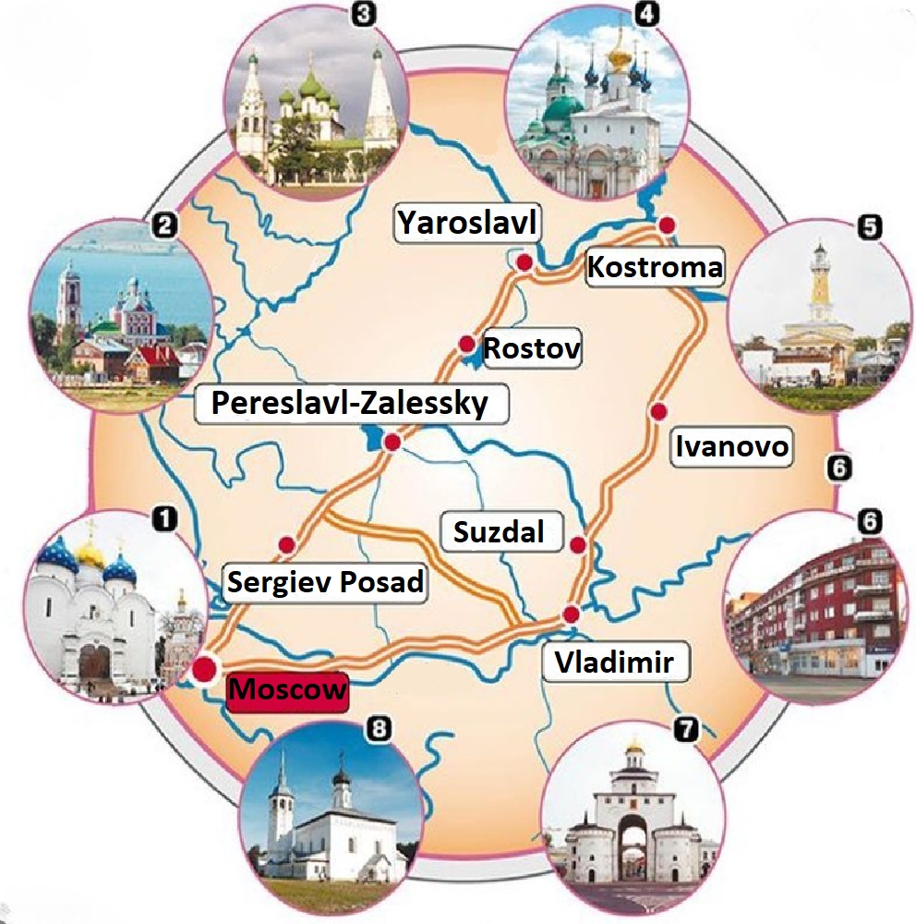
Golden ring cities on the map
Yaroslavl is located on the banks of the Volga River 282 km north-east of Moscow.
Rostov-on-Don is located in the south of Russia, in the lower reaches of the Don River, not far from the place of its confluence with the Sea of Azov.
Pereslavl-Zalessky is located 130 km north-east of Moscow and 120 km south of Yaroslavl, on the shore of Lake Pleshcheev, at the confluence of the Trubezh River.
Kostroma is located in the central part of Russia, northeast of Moscow (about 300 km), on both banks of the Volga, not far from the Gorky reservoir.
The city of Sergiev Posad is located in the north-east of the Moscow region, more than 50 kilometers from the capital, the Konchura River flows through its territory, dividing the city into three parts.
Ivanovo is located on the banks of the Uvod river, the distance from Moscow is 275 kilometers.
Suzdal is located on the shallow Kamenka River in the Vladimir region.
Vladimir is predominantly on the left bank of the Klyazma River, 176 km east of Moscow.

Slide 4
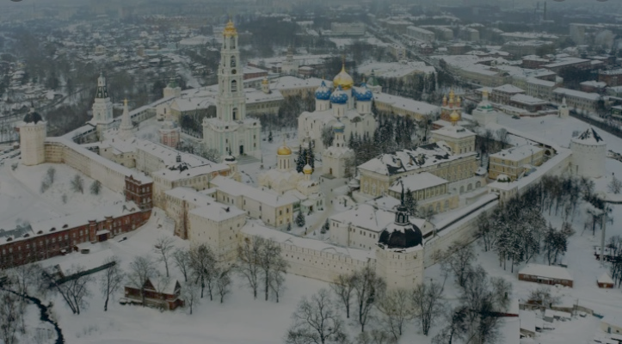
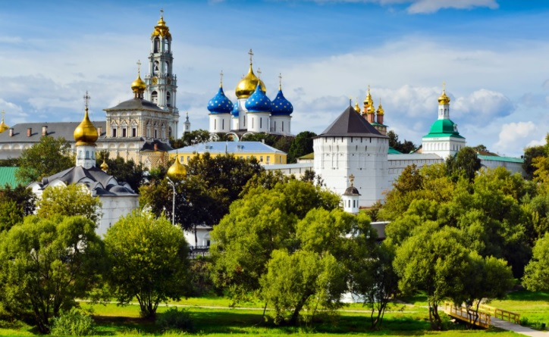
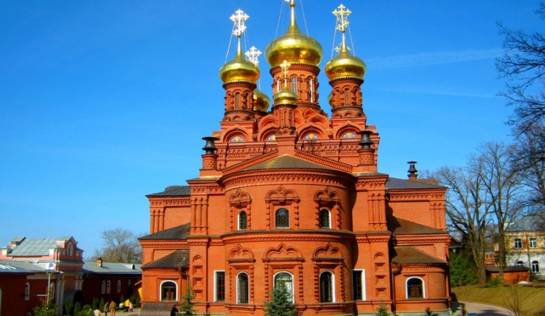
SERGIEV POSAD
At the entrance to Sergiev Posad from the top of the hill there is a breath-taking view of the Trinity Monastery of St Sergius. It is the historical centre of Sergiev Posad. It was founded in the middle of the 14th century by Sergius of Radonezh. Since 1744 the Trinity Monastery of St Sergius is a laura. The word “laura” translated from the Greek means “a most important monastery”.
The unusually high bell-tower dominates the whole ensemble. The mass of churches and other buildings creates a joyous, uplifting
sensation, particularly on sunny days, and recalls pictures of gingerbread towns on old woodcuts. This is one of Russia’s most important and highly revered monasteries, which still retains its greatness and renown. Here lie the relics of Sergius of Radonezh, that bring thousands of pilgrims here each year to do homage.
In the Soviet period Sergiev Posad was renamed Zagorsk in honour of the revolutionary Zagorsky, but in 1991 it got its old name back.

Slide 5
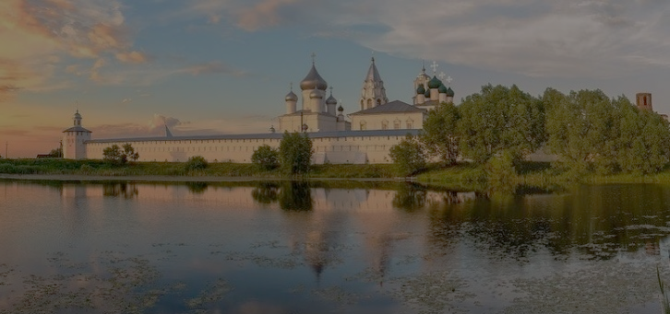
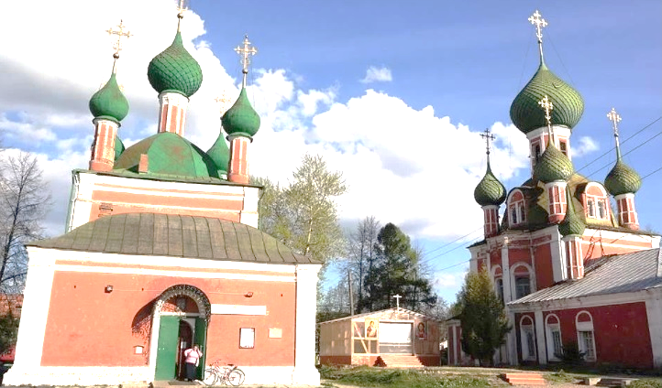
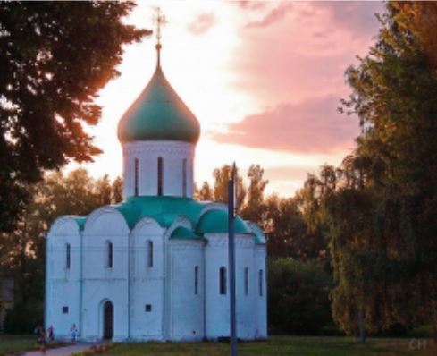
PERESLAVL-ZALESSKY
Pereslavl-Zalessky was founded in 1152 by Prince Yuri Dolgoruky.
The population of this town is about 45 000 inhabitants.
One of the finest pages in the history of Pereslavl-Zalessky is connected with Peter the Great. On the banks of Lake Pleshcheyevo Peter the Great set about building the first Russian flotilla “for fun”, which marked the beginning of the Russian fleet.
Lake Pleshcheyevo is 9,5 km long and 6,7 km wide with a maximum depth of about 30 metres. It is one of the largest lakes in Central Russia. The lake that rocked the first ships of Russia’s sea fleet deserves to be called a sea. What is more the lake really does have the so-called Pereslavl herring, which is actually not herring at all, but a unique sort of whitefish (among other sorts) from the salmon family that specialists regard as a sea relict and still argue about how it could appear in a closed freshwater lake. Then this fish was called the ryapushka. A tender delicacy, it satisfied the most demanding palate and was always on the menu of the tsars and patriarchs during fasting.
There are four monasteries in Pereslavl-Zalessky. One of them is the Goritsky Monastery. It was founded in 15th century. The monastery got its name from its location on high ground by the edge of a slope.

Slide 6
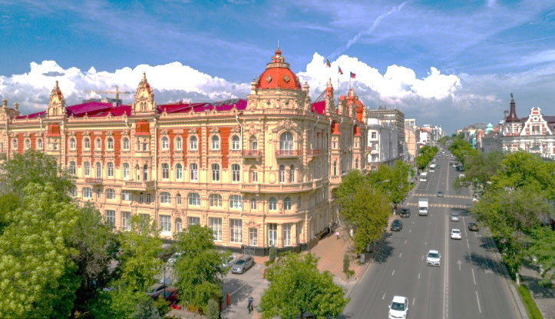
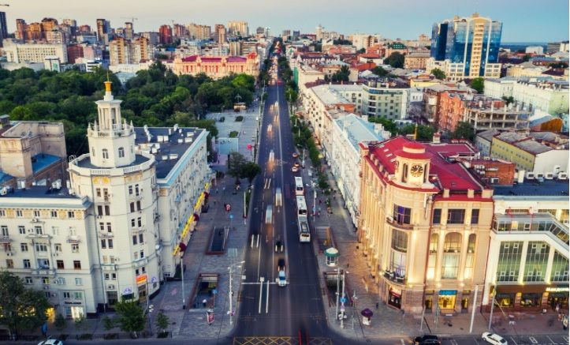
ROSTOV THE GREAT
Rostov the Great was founded in 862. The population is about 37 000 inhabitants.
The historical centre of Rostov the Great is the Rostov Kremlin. It was built in late 17th century. The splendid ensemble of the kremlin dominates the surroundings creating a very special festive atmosphere. Everything here speaks of bygone days, remote pages of Russian history.
Besides, there are two monasteries in Rostov the Great – the Saviour Monastery of St Jacob and the Abraham Monastery. They were built in 14th and in 11-12th centuries respectively.
Yet Rostov the Great is famous for the Rostov enamels. In the 18th century Rostov became a centre for producing enamel insets and individual articles. The insets were used mainly to decorate church plate. The enameled insets depicting subjects were multi-coloured, necessitating several firings, and were particularly valued. With time the demand for these insets decreased, and the masters turned instead to making powder cases, hand mirrors, earrings, bracelets and portrait brooches.

Slide 7
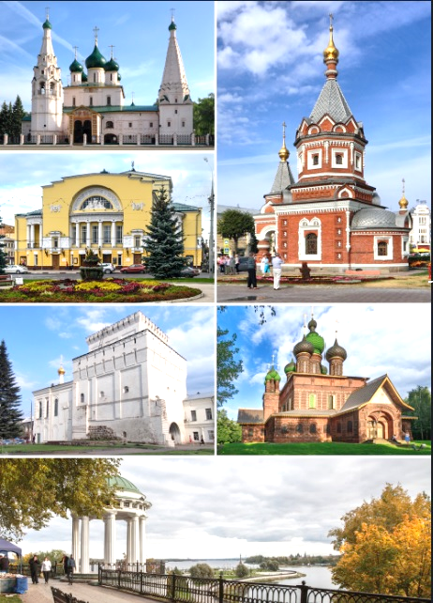
YAROSLAVL
Yaroslavl is the largest and most active of the Golden Ring towns. It was founded at the beginning of the 11th century by Prince Yaroslav the Wise of Kiev as a fortified town on the right bank of the Volga at the point where the Kotorosl flows into it.
The population of Yaroslavl is about 628 000 people.
There are many churches in Yaroslavl. The Church of St Elijah the Prophet (1647 – 1650) is one of the most beautiful. It is situated in the centre of Yaroslavl, on the town’s main square, Sovietskaya.
Besides, Yaroslavl is famous for the Saviour Monastery. It was founded in the second half of the 12th century. After a fire in 1501 the monastery buildings were rebuilt in stone.

Slide 8
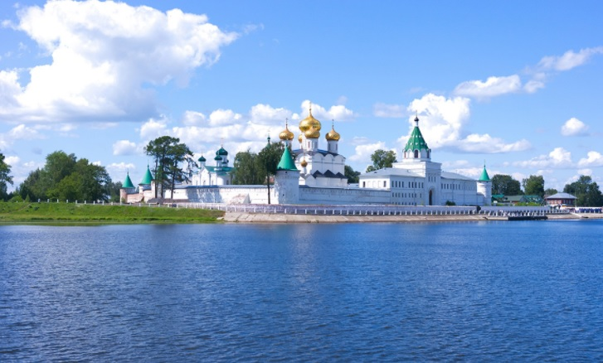
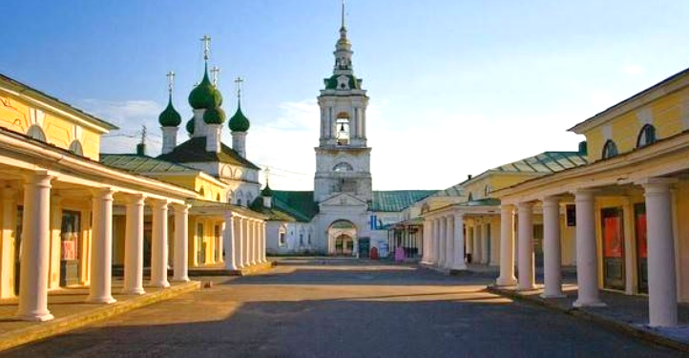
KOSTROMA
Kostroma was founded in 1151 by Prince Yuri Dolgoruki of Suzdal.
The population of Kostroma is about 286 000 inhabitants.
Kostroma is famous for the Hypatian Monastery and the open-air Museum of Wooden Architecture.
The Hypatian Monastery is situated on the promontory between the Volga and the Kostroma. It was founded in 1275.
The open-air Museum of Wooden Architecture is located in a picturesque meadow by the River Igumenka. Here you will find churches, log cabins and other buildings from all over Kostroma Region.
The best souvenirs to take home from Kostroma are the beautiful items made of pure linen. The bright and attractive linen tablecloths and napkins on the trays of local traders are real works of art.

Slide 9
Questions
Sergiev possd was founded by Prince Yuri Dolgoruky?
Pereslavl-Zalessky was founded in 1152?
Is there only one monastery in Rostov the Great?
Is the population of Yaroslavl over 1,000,000 people?
Yes
No
Yes
No
Yes
No
Yes
No
Yes
No
Yes
No
Yes
No
Yes
No

Slide 10
The most important thing
Town | Year of foundation | Founder | Location | main Attraction
Sergiev Posad | 14th | Sergius of Radonezh | On the Konchura River flows through its territory, dividing the city into three parts. | Trinity Monastery
Pereslavl Zalessky | 1152 | Prince Yuri Dolgoruky | On the shore of Lake Pleshcheev, at the confluence of the Trubezh River | Lake Pleshcheyevo
Rostov the Great | 862 | Meryan leader of Rost | On the lower reaches of the Don River | Abraham Monastery
Yaroslavl | 11th | Prince Yaroslav | On the banks of the Volga River | Sovietskaya square
Kostroma | 1151 | Prince Yuri Dolgoruki | On the left bank of the Volga River | The Hypatian Monastery

Slide 11
Thank you for attention!

